Slide 1

Group 2 – Project 3 Fractional Property Ownership
Natalia Elmowafi, Reynoldo Slater, Jack Thomeer and Vu Do
November 23, 2020

Slide 2
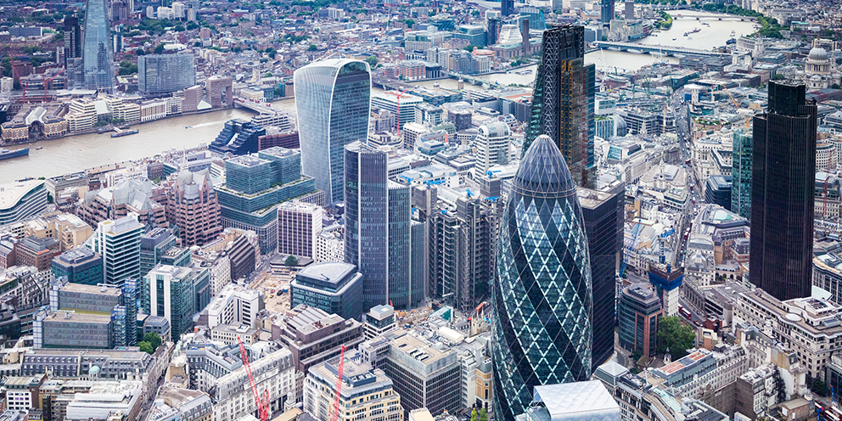
Agenda
Business Problem
Product Overview & Business Value
Architecture
Demo
Personas
Features & Workflows
Product Demo

Slide 3
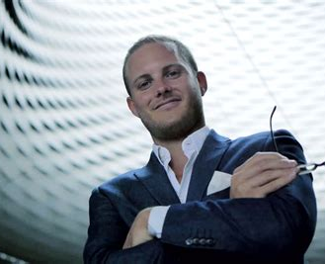

Business Problem
Do you have some extra money you would like to invest but not enough to buy a property?
Want to buy a house but rejected for mortgage?
Facing foreclosure? Have a little time to solve the delayed payments issue with bank?
Inherited some property and worried about
process with all the legal parties involved?

Slide 4
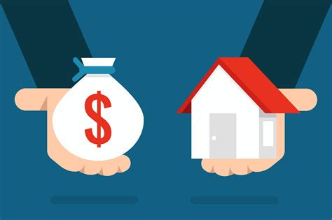
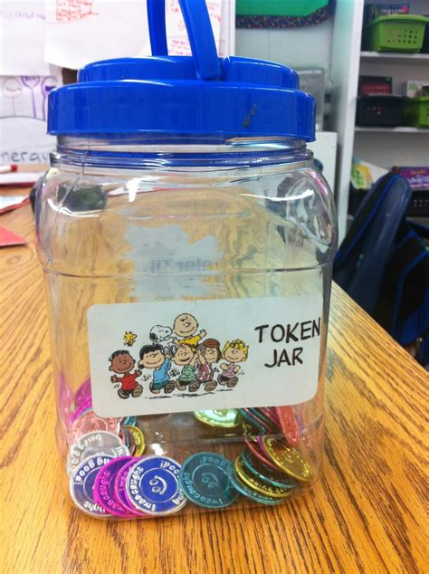
Product Overview
Own a real estate or part of it, in a nontraditional way! NO massive capital for investment needed.
Safe, legal and easy way to keep the property, if facing foreclosure by giving up a partial ownership of the property.
Possibly could be used by banks on already foreclosed properties.
No need for Real Estate license, title companies, therefore no additional spending for the fees.
no previous experience needed, easy to access at any part of the Globe.
Notes:
Our software allows middle class to own real estate in a nontraditional way, without a massive capital available for investment.
2) Also, this is a saver way to keep the property for people who are facing foreclosure by giving up a partial ownership of the property.
consumers can buy/sell a fraction of the real ( % ownership represented by tokens) without any real estate experience and therefore involvement of additional (traditional) parties in buying/selling process (RE agents, title companies, lawyers, etc)., which eliminates the additional spending for the fees.
Minimal involvement in managing contract and tokens. Self – maintained contract, so to speak

Slide 5

Value Statements
Our Software used for:
Limited capital available for an investment property
Easy profit split once property rented. ( NO need to pick up rent checks, deposit into bank account, calculate the split amount)
Potential foreclosurers - safe and quick way to solve delayed payment on mortgage issues without additional expenses (moving to another place/deposit to the apartment .
Consumers can buy/sell a fraction of the real ( % ownership represented by tokens) without any real estate experience or involvement of additional (traditional) parties in buying/selling process (RE agents, title companies, lawyers, etc). That eliminates the additional spending for the fees.
Minimal involvement in managing contract, tokens and property.
Notes:
How does this product create value? Tie the value creation to core problems you started with?
Complication in profit splitting for an investment property .Tokenizing fractions would make transition of ownership easier without paying additional fees effortlessly. ( NO need to pick up rent checks, deposit into bank account, calculate the split amount)
For potential foreclosurers this scenario gives opportunity to stay in their home by giving up a part of their ownership of the house without damaging credit history, having additional expenses from moving to another place/deposit to the apartment . They could stay in their house by paying rent (the foreclosurer could still have a fractional ownership of their property )
consumers can buy/sell a fraction of the real ( % ownership represented by tokens) without any real estate experience and therefore involvement of additional (traditional) parties in buying/selling process (RE agents, title companies, lawyers, etc)., which eliminates the additional spending for the fees.

Slide 6

Value Statements – using new technology
Trusted validation without title company involvement (confirmation available to view)
Self – maintenance of the contract which eliminates involvement of additional parties (expenses) .
Trusted place to complete all the functions of the contract that couldn’t be tampered with.
A single secure place to have all the information for investment property sharing.
Peer-to-peer transactions (trustable payments methods fraud free)
Split payment between big parties. If there’s a disagreement could reference the contract on the blockchain that’s been unaltered.
Anywhere access to application for business user. Solely digital.
No experience or specialized licenses needed.
Notes:
Are there features of blockchain technology that influence solution design?
Validation of the ownership documents (title, mortgage) performed by government entity. Once verified, unique registration number provided and could be verified at any time, attached to the blockchain. Very Trusted validation. without title company involvement.
Self – maintenance of the contract which eliminates involvement of additional parties, such as title companies, RE agents, property management. Once contract starts, the calculations and running functions will take care of the rest automatically (tokens sold, distributed and stored, profit of the rent and the distribution to the users). If there’s a disagreement, could reference the contract on the blockchain that’s been unaltered.
Trusted place to complete all the functions of the contract that couldn’t be tampered with.
A single secure place to have all the information for investment property sharing
Peer-to-peer transactions (trustable payments methods fraud free)
Split payment between big parties. If there’s a disagreement could reference the contract on the blockchain that’s been unaltered. Financial
Anywhere access to application for business user
By using blockchain contracts, consumers can buy/sell a fraction of the real ( % ownership represented by tokens) without any real estate experience and therefore involvement of additional (traditional) parties in buying/selling process (RE agents, title companies, lawyers, etc)., which eliminates the additional spending for the fees.

Slide 7
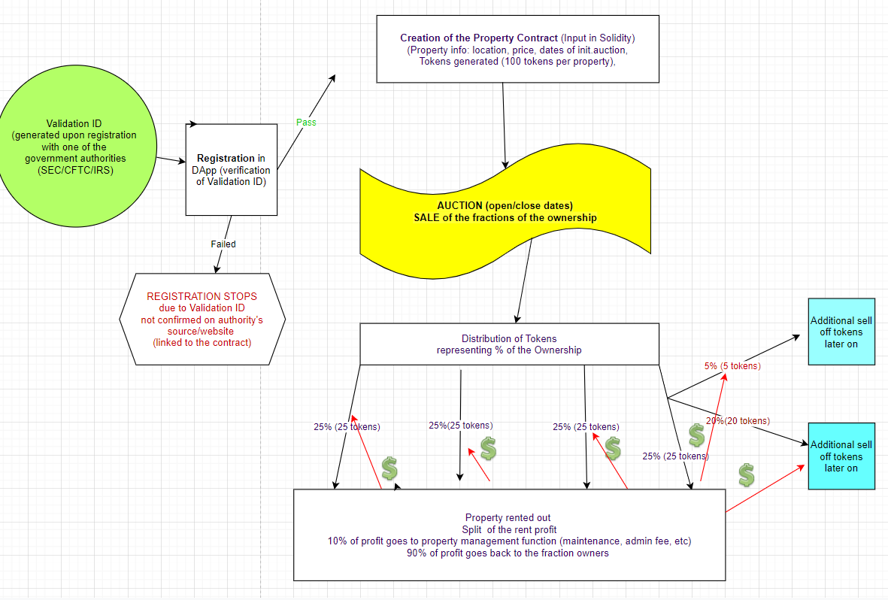

Slide 8

Property Seller
Who is that persona?
to liquidate their property without additional expenses and for as much value as possible;
A person inheriting a property;
What would this persona find novel?
Ability to list their property to a broader market of people – sell faster;
Ability to list their property for full asking price within a certain time range;
Ability to divide a property into shares;
No need to involvement of licensed professionals (no fees);
Solely digital interaction;

Slide 9
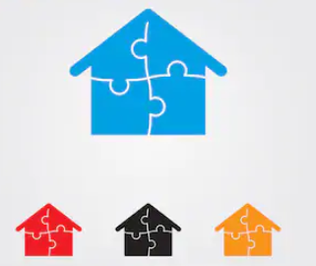
Property Fractional Owner
Who is that persona?
middle class professional who would like to invest in a safe long term passive income
What would this persona find novel?
Ability to buy a fraction of the property with the capital they have without any loans, additional fees;
Ability to receive a profit from rent with minimum involvement and without additional parties(less fees, more profit);
Ability to resale a property fraction;
Ability to buy fractions of the several properties in a high desired locations;
Solely digital interaction;

Slide 10
Workflow – flat Ownership in London
Original owner
Owner Registers
Register Property
Auction of the Tokens representing the Property Ownership (100 token for 100% as an example)
Fractional Owners
Sell Few owned Tokens
Buys Tokens during auction period
Receives profit from rent
Fr. Owner Registers
Sell ALL Tokens
Contract payment of the rent profit/ distribution to all fractional owners received from the renter
Renter (out of scope for now due to time limitation)
Rent Home

Slide 11

Demo

